Slide 1
The Treaty Of Versailles
And The Effect It Had On Germany

Slide 2
The Treaty of Versailles
The Treaty of Versailles was a peace settlement signed after the World War in 1918
It was signed at the Versailles Palace near Paris between Germany and the Allies
Georges Clemenceau, David Lloyd George and Woodrow Wilson – ‘The Big Three’ at the conference. The treaty was decided mainly by them.
The treaty was signed on June 28th 1919

Slide 3
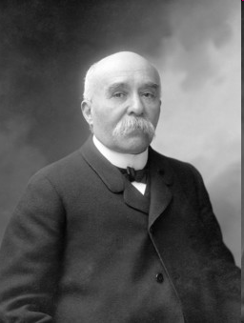
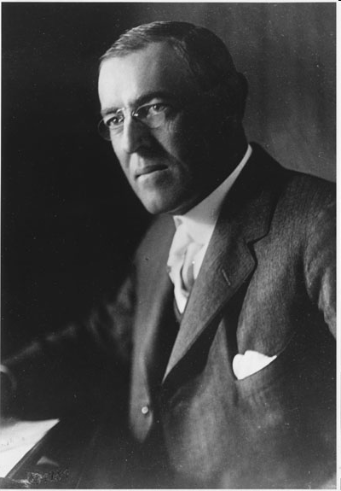
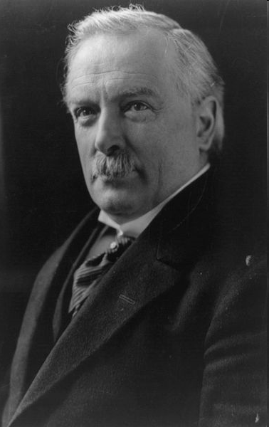
The Big Three
And their Opinions

Slide 4
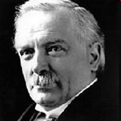
David Lloyd George
Britain
He was a politician and so had to also take the public’s opinion
The British public had two opinions – “Hang The Kaiser” and “Make Germany Pay”
So he too portrayed these views
Actually, he was concerned about communism taking over Russia at around the time all this was happening and wanted to treat Germany in such a way that if and when the communism spilled over into Germany it should not effect them
But, if they were too harsh on Germany, the people would rebel and turn to communism
So he said that they shouldn’t be too harsh on Germany

Slide 5
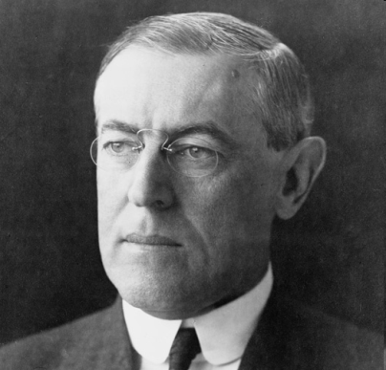
Woodrow Wilson
USA
He genuinely wanted world peace and wrote the world famous 14 Points for peace
The American public wanted the US to adopt ‘isolationism’ or a belief in which they were to stay isolated from the rest of the world
He wanted to create a League of Nations in which all countries were included
He thought that Germany should be punished but not too harshly as other wise they would want to get revenge

Slide 6
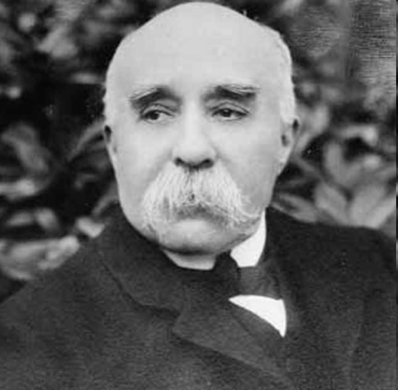
Georges Clemenceau
France
He just had one belief – Germany should be crippled and badly punished
The French Public also believed the same
Germany had attacked France once many years ago and France hadn’t done too well, he wanted to make sure that they don’t attack again

Slide 7
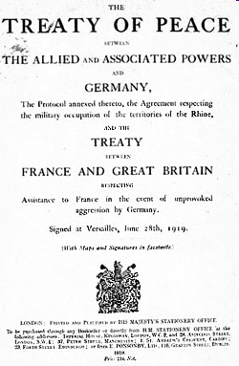
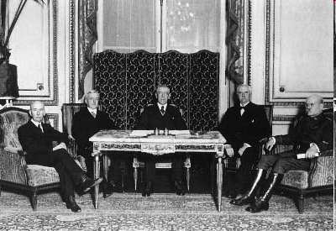
The Terms of the Treaty
Decided by mainly ‘The Big Three’ and Germany’s opinion not taken

Slide 8
Military
Germany could only have an army of 100,000 people
No air force
West Rhineland demilitarised
Allies to keep army west of Rhineland for 15 years

Slide 9
Territorial
West Prussia, Posen and Upper Silisia to Poland
Alsace-Lorraine to France
Hultschin to Czechoslovakia
Eupen and Malmedy to Belgium
Northern Schleswig to Denmark
Saar, Danzig and Memel and Germany’s Russian territories to League of Nations

Slide 10
General
Germany had to accept full guilt for starting the war – the ‘War Guilt Clause’
League of Nations set up; but Germany was not included

Slide 11
Financial
After the war, Germany’s economy was bad
Since Germany had taken full war guilt they had to pay high reparations which would go mainly to France and Belgium. These could be in cash or in kind
Vital industrial territory (Saar and Upper Silesia especially) were lost
Germany wasn’t allowed to combine with Austria to make a super-state so that her economy could be kept to a minimum

Slide 12
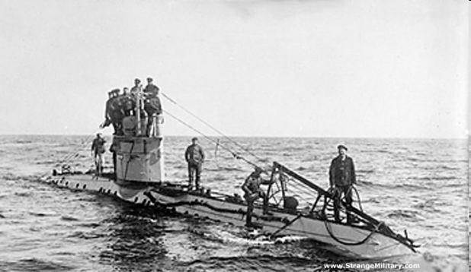
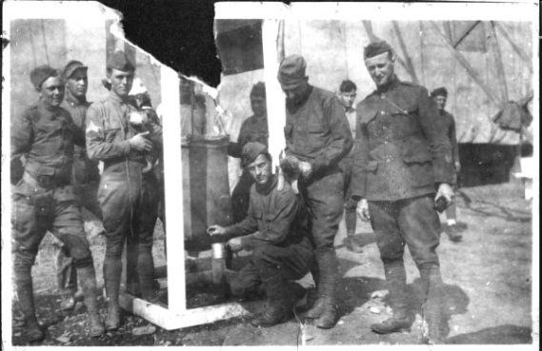
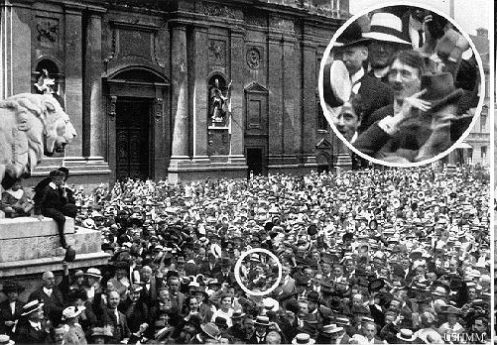
Reaction of the Germans to the terms of the treaty

Slide 13
After agreeing to the Armistice, Germans were confident that they would be consulted by the Allies before the treaty was made
This didn’t happen and the German’s were furious but didn’t have the money or army to continue the war
When they were consulted just before signing, they felt the terms were extremely unfair
After the terms were made public, they became known as ‘Diktat’ as they were forced to sign with no choice
As a mark of protest, the German Navy scuttled its ships at The Scapa Flow (North of Scotland)

Slide 14
They now had two choices → Sign the treaty or be invaded by the Allies
They signed the treaty as in reality they had only one option
After the ceremony was over, Clemenceau was heard saying “It is a beautiful day!”

Slide 15
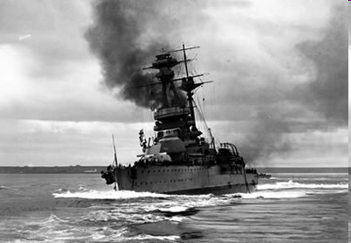
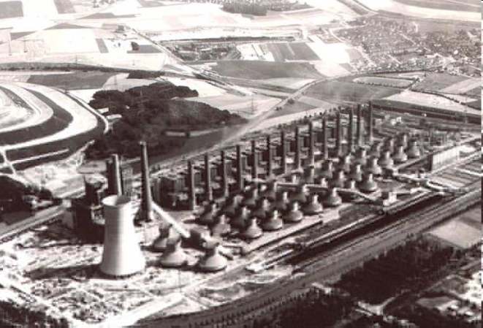
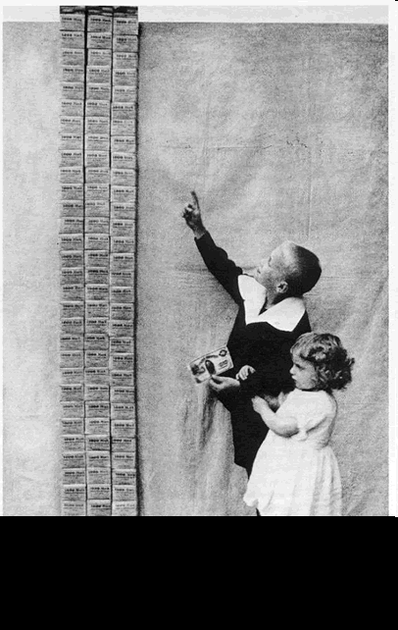
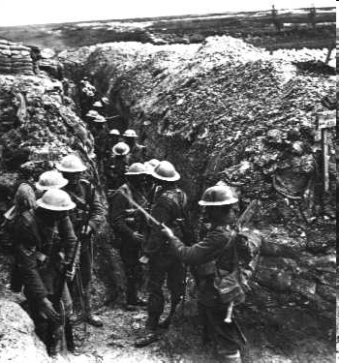
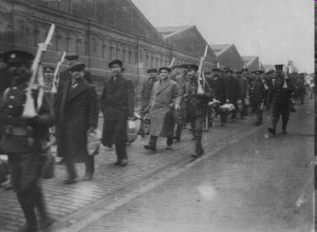
Consequences

Slide 16
The Big Three were satisfied with the treaty; they thought it was just as it weakened Germany but still kept her strong
It kept the French border safe from attacks from Germany
They had also created The League of Nations which they thought would make world peace for sure

Slide 17
However, The German’s did not agree, the treaty left them angry as they felt that Germany as a nation had been treated unfairly
They hated the “War Guilt Clause” and the “Reparations Clause”
The German officials who signed the treaty came to be know as the “November Criminals”
Many Germans felt they were being punished because of something the Government did (Start the war)
The German’s weren’t able to pay the reparations which were 6600 million pounds
They paid 50 million pounds in 1921 but couldn’t pay anything in 1922
So, in January 1923, French and Belgian troops invaded Ruhr (It was actually legal according to the treaty) and they took food and other supplies that they wanted to take

